Slide 1
File Management
Paths and Trees and Folders

Slide 2
Outline
Operating Systems
File Basics
File Names, Extensions
Directories, Folders, and Paths
File Formats
File Management
File (Windows) Explorer
Zipping files
Shortcuts

Slide 3
Operating Systems
Every computer runs programs (applications) that help you do your work, like word processors and browsers.
Every computer needs software that knows the details of the particular hardware you have and can communicate with all your applications and with you. This is the Operating System.
Several kinds of OS’s – Windows 7, 8, 10, Linux, MacOS, Unix, Android
All operating systems have the important job of keeping track of your files: where they are, what’s in them, what they are named.

Slide 4
Files
When you use an application to do work - e.g., write a paper, make a spreadsheet, or draw a picture, the work is stored in RAM (memory) first
It is in danger of being lost if the power goes off (RAM is volatile!)
When you save it, it is copied to a secondary storage device like the hard drive or a flash drive
It is saved as a FILE with a name, extension, time, date, size

Slide 5
File Names and Extensions
You must adhere to file-naming conventions when saving files
Case sensitivity – upper and lower case are different
True in Linux and Unix variations, not in Windows
Maximum length (Windows 260 characters)
Spaces allowed
Digits allowed
\ / : * ? " < > | not allowed
File names not allowed (con, nul, prn)
File extensions provide clues to the file contents
OS uses extensions to know which application created the file and the internal format of the file

Slide 6
Filename Extensions
Extension | Type of Document | Application
.doc or .docx | Word processing document | Microsoft Word
.xls or .xlsx | Workbook | Microsoft Excel
.ppt or .pptx | PowerPoint presentation | MS PowerPoint
.accdb | Database | Microsoft Access
.gif, .jpg, .png | Images | Windows Image Viewer
.mp4, .mp3 | Videos, audio | Windows Media
.zip | Compressed file | WinZip
.pdf | Portable Document Format | Adobe Acrobat
.htm or .html | Web page | Hypertext Markup Language

Slide 7
How to Make Extensions Visible in Windows
Windows default is NOT to show the common extensions of filenames but we want to SEE them!
Open a Windows Explorer window
Choose Organize tab
Choose Folder and search options
Choose View tab
UNcheck the box that says “Hide extensions for known file types”
Choose “Apply to Folders”

Slide 8
File Systems – Drives
Every computer has a file system used to keep track of the files on that machine
File systems are based on physical storage devices, known as drives
Drives can be local or remote (network or cloud)
Click on “My Computer” to see a list of drives (on a Windows machine)

Slide 9
File Systems – Drives
Typical Drives
A: or B: → Floppy Disk
C: → Local Hard Drive
D: → CD Drive
E-Z for removable drives like memory sticks
About any letter can be used for a partition of a device
WATCH OUT for the D drive on lab machines! It is another hard drive that is not erased when you log out! Do not leave your work on there!

Slide 10
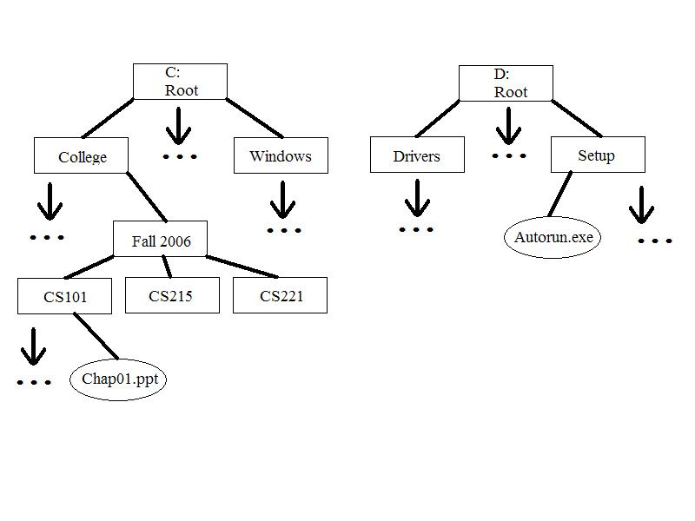
A File System Tree (2 devices)

Slide 11
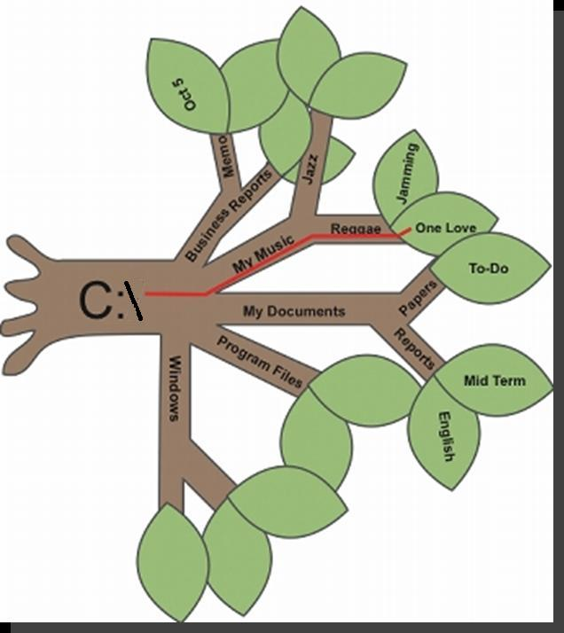
File Management Metaphors
Tree Metaphor
Root, branches, leaves
Filing Cabinet Metaphor
Drawers, Folders, Files

Slide 12
File Directories and Folders
Every storage device has a directory containing a list of its files
Root directory (like “C:\”)
Subdirectory
Depicted as folders
A computer’s file location is defined by a path
Examples: D:\ is the root of the D drive
Examples: C:\Notes\CS 101\Week 1\notes.txt
Examples: F:\1999\Music\CDs\Prince\

Slide 13
File Formats
A file format refers to the organization and layout of data that is stored in a file
A file extension usually indicates the format of a file and the application which was used to create the file
But it does not have to! Just changing the extension on a file from xlsx to zip does not make the file a zip file! It needs to be converted from a spreadsheet to a zipped file using the zip application.

Slide 14
Applications and Files
Most applications that create files have a file menu
Choices will include Save and Save As
Save saves using same filename, if has been saved once already
Save asks for new name if it has not been saved before
Save As asks for new name and saves new copy of file
Duplicate – makes another copy with new name but you keep editing old version
Rename – allows you to change the name of the current file

Slide 15
File Management
The operating system provides an organizational structure to the computer’s data and programs
Hierarchical structure of directories:
Drives
Folders
and more Folders …
Files
Storage metaphors help you visualize and mentally organize the files on your disks and other storage devices
Notes:
An additional function of the OS is to enable file management, which entails providing organizational structure to the computer’s contents. The OS allows you to organize the contents of your computer in a hierarchical structure of directories that includes drives, folders, subfolders, and files.
.

Slide 16
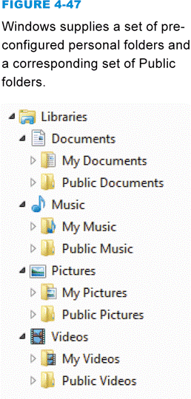
File Explorer
File Explorer (also known as Windows Explorer) helps you manipulate files and folders in the following ways:
Rename
Copy
Move
Delete
Windows offers a set of preconfigured personal folders, such as My Documents and My Music, for storing your personal data files. You can make subdirectories in these too!

Slide 17
Windows Explorer
NOT the same as Internet Explorer! Windows Explorer is a file manager
Shows files in different views
Shows files’ information: name, date modified, type, size and others you can set (Turn menu bar on, then View then menu choice Choose Details)
Uses Graphical User Interface to let you move files around, copy them, erase them

Slide 18
Units for measuring file sizes
One byte = one character, pretty small
1 Kilobyte = 1024 bytes, about a page of text
1 Megabyte = 1024 KBs, a 1000-page book
1 Gigabyte = 1024 MBs (more than 1 billion bytes), about 1000 books, a library!
1 Terabyte = 1024 GBs (more than 1 trillion bytes), over 1000 libraries
1 Petabyte = 1024 TBs (more than 1 quadrillion bytes), over 1 million libraries

Slide 19
Relationships of units
1024 = 512 * 2
1024 = 256 * 4
1024 = 128 * 8
1 Gb = 1024 Mb
So 0.5 Gb = 512 Mb
And 0.25 Gb = 256 Mb
If I had 7 512 Mb files and a 2 Gb memory stick, would they all fit? How much space left over? How much more needed?

Slide 20
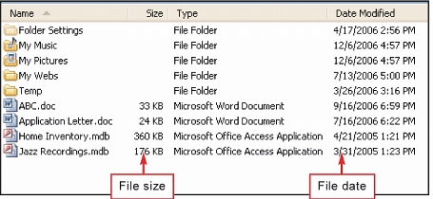
File Sizes and Dates
A file contains data, stored as a group of bits
File size is usually measured in bytes, kilobytes, or megabytes
The file date indicates the date that a file was created or last modified

Slide 21
File Sizes and Dates
Why is the file size important?
Memory and Storage Capacity
“How many songs can I fit on my MP3 player?”
“How many pictures can I take with my camera?”
"Did all my data get saved?“
“Did I submit a file for the lab test that was empty?”
Why is the file date important?
History of File Creation and Last Modification
“Which one is the latest version of my paper?”
“Did I submit my lab test on time?”

Slide 22
File Management Tips
Use descriptive names
Maintain file extensions – don’t change one unless you convert the file to that type
Group similar files into a folder
Organize your folders from the top down
Consider using default folders but consider putting folders inside them – My Documents can be subdivided as you like!
Do not mix data files and program files in the same folder

